Slide 1

UE20CS390B – Capstone Project Phase – 2
SEMESTER - VII
END SEMESTER ASSESSMENT
Project Title : Deploying EOX microservice to Kubernetes cluster
Project ID : PW_23_VP_01
Project Guide : Prof Venkatesh Prasad, Mr. Vijay R(EOX Vantage)
Project Team : Veena Garag PES1UG20CS492
Adarsh Kumar PES2UG20CS016
Suchit S Kallapur PES1UG20CS438
Yuvaraj D C PES1UG20CS521

Slide 2
Team Roles and Responsibilities
Deploying EOX microservice to Kubernetes cluster
Yuvaraj dc | Created Kubernetes cluster and setup monitoring tools. deployed mongodb-express application on server instance and exposed it to public.
Veena Garag | Implementation of custom scheduler and demonstration using nginx application. Comparison between default KHPA and custom scheduler.
Suchit S Kallapur | Worked on setting up prometheus and grafana using helm charts
Adarsh Kumar | Worked on testing, monitoring tools - locust and kiali. Setup of Matrix Server for Custom Controller.

Slide 3
Summary of Requirements and Design
Deploying EOX microservice to Kubernetes cluster
Deploying microservices on Kubernetes cluster.
To be able to handle large user at a time.
Use minimal resources as much as possible.
Spin up and spin down of the microservices based on the number of users using the application.
Implement Kubernetes monitoring and logging using tools such as Prometheus, Grafana.

Slide 4
Design Constraints & Dependencies
Deploying EOX microservice to Kubernetes cluster
Constraints:
Resource Availability: Availability of adequate hardware resources, such as CPU, memory, and storage, can limit the application's scalability.
Dependencies:
Kubernetes: The project relies on Kubernetes as the underlying container orchestration platform for managing microservices deployments.
Istio Mesh Networks: Istio provides service-to-service communication and visibility, enhancing application observability and control.
Kiali and Prometheus: Kiali and Prometheus are employed for comprehensive monitoring of microservices, collecting metrics on resource utilization, request latency, and other performance indicators.
Grafana: Grafana serves as a centralized dashboard for visualizing and analysing metrics collected by Kaili and Prometheus, providing insights into application behaviour and performance.

Slide 5
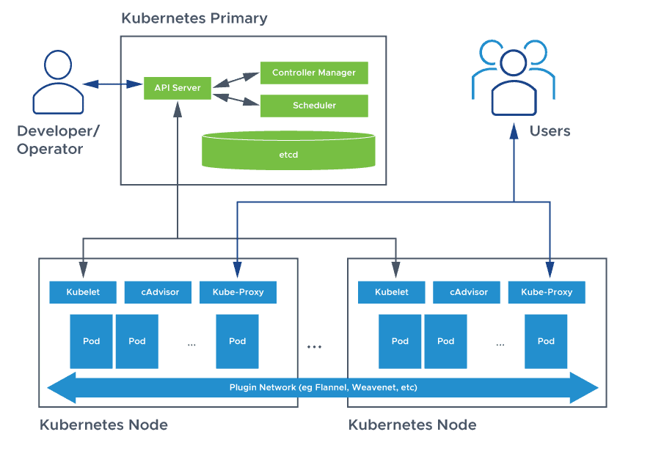
Design of Project
Deploying EOX microservice to Kubernetes cluster

Slide 6
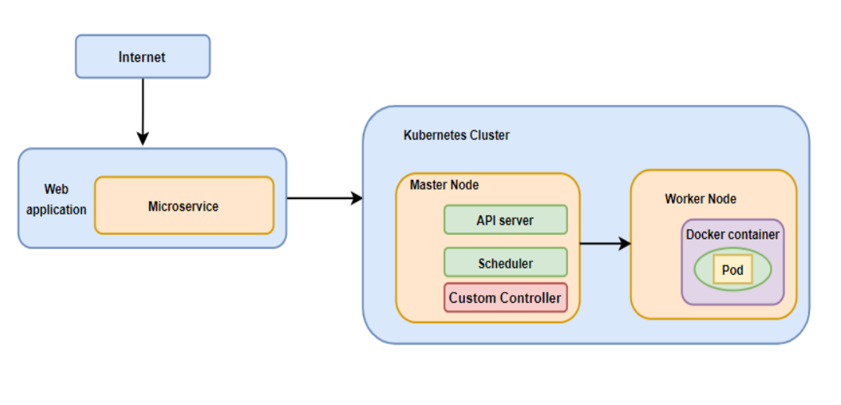
Deploying EOX microservice to Kubernetes cluster
To the kubernetes control plane above, an extra component called the custom controller will be implemented to determine the number of pods to be scheduled for the microservice.
Communicate with other components of control plane via api calls to change the state of the data plane.

Slide 7
Deploying EOX microservice to Kubernetes cluster
Advantages and disadvantages of the proposed approach
Benefits:
Reduces the number of pods allocated
Optimize the cpus usage
Gives more control over the the resources
Drawbacks:
Implementing a new entity ie, custom scheduler in the master node adds complexity.
Platform becomes more complicated when multiple solutions are integrated (scaling and optimal cpu utilization – custom scheduler and security and metric monitoring – istio service mesh).

Slide 8
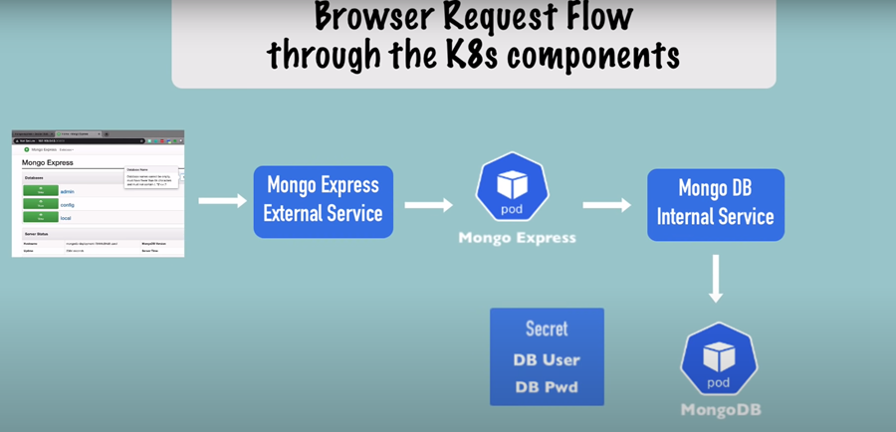
Deploying EOX microservice to Kubernetes cluster
Deploying sample application on EOX-server instance

Slide 9
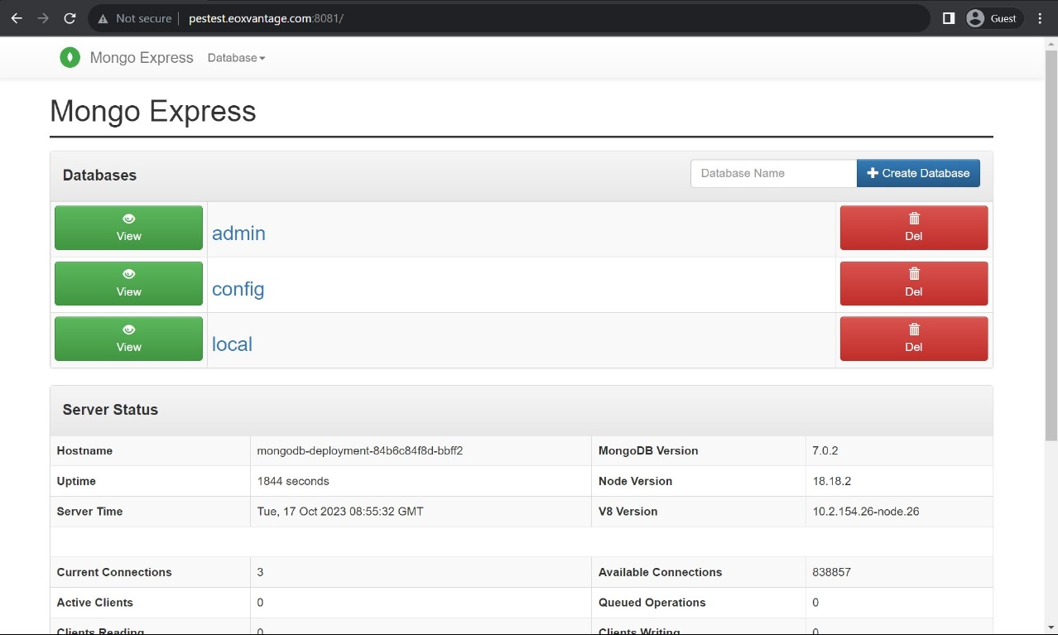
Deploying EOX microservice to Kubernetes cluster

Slide 10
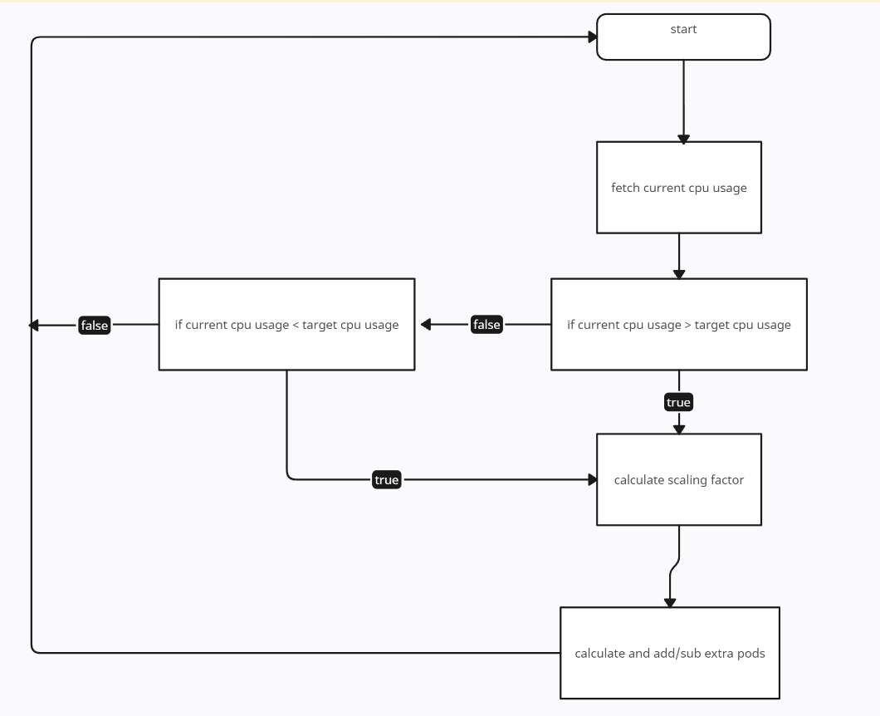
Deploying EOX microservice to Kubernetes cluster
Design Description
Implementation of custom controller: logical workflow

Slide 11
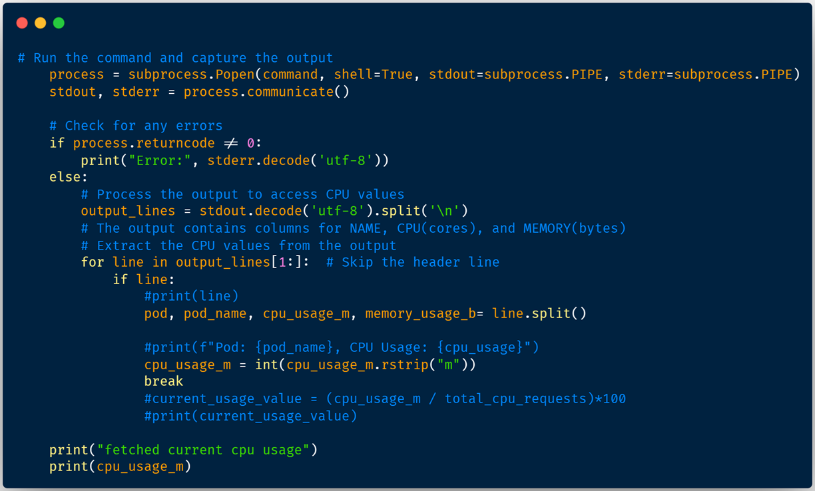
Deploying EOX microservice to Kubernetes cluster
Code Snippets

Slide 12
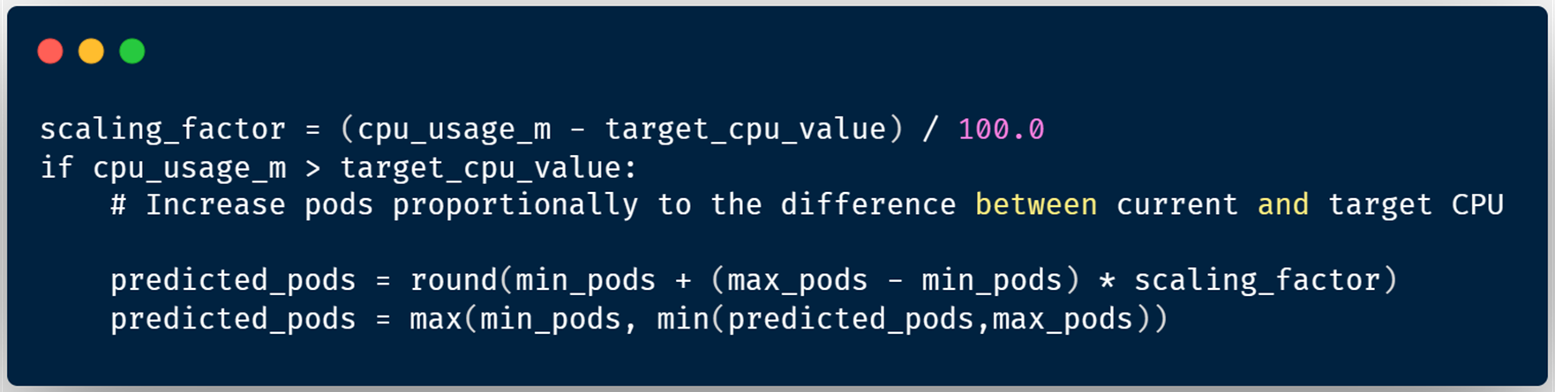
Deploying EOX microservice to Kubernetes cluster
Scaling Algorithm

Slide 13
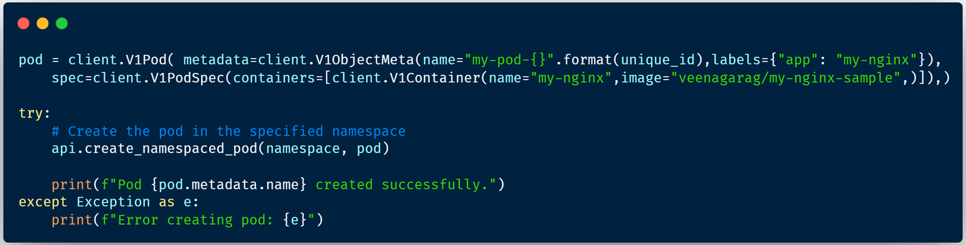
Deploying EOX microservice to Kubernetes cluster
Code Implementation

Slide 14
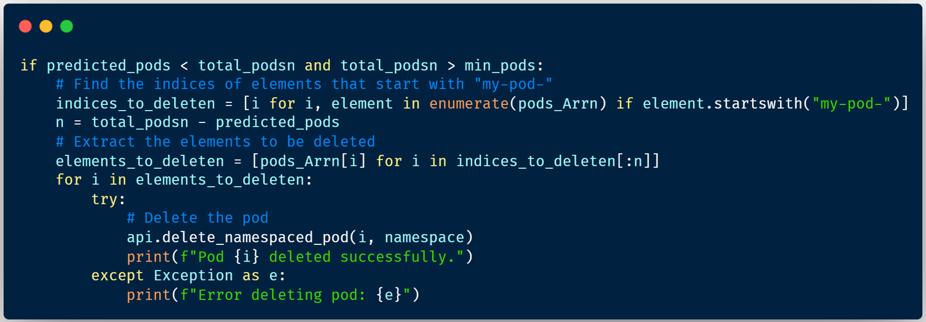
Deploying EOX microservice to Kubernetes cluster
Code Implementation

Slide 15
Test Plan and Strategy
Deploying EOX microservice to Kubernetes cluster
Testing and Validation: Conducted testing to validate the auto-scaling functionality and performance. Employed unit tests, and load tests to ensure the auto-scaler can effectively scale the application under various load conditions.
Deployment and Monitoring: Deploy the auto-scaler to the local environment and monitor its performance closely. Continuously evaluate the auto-scaler's effectiveness in handling workload fluctuations and maintaining application performance.

Slide 16
Test Plan and Strategy
Deploying EOX microservice to Kubernetes cluster
Using locust requests are swarmed, in 2, 8, 15 min time frames:
I. 3000 users and 600 rps
II. 200 users and 50 rps,
and observed for the number of pods allocated by the algorithms
locust
kubernetes cluster
metric monitoring
Veena_Adarsh_Suchit_Yuvaraj

Slide 17
Results and Discussion
Deploying EOX microservice to Kubernetes cluster
The project successfully implemented a custom controller auto-scaler, enabling dynamic scaling of the microservices-based application.
Through a comparative analysis of the Horizontal Pod Autoscaler (HPA) algorithm and our custom controller, our algorithm demonstrated superior performance compared to the default algorithm. This enhanced efficiency resulted in improved resource utilization and application responsiveness.

Slide 18
Result and discussion
Deploying EOX microservice to Kubernetes cluster
Algorithm Used(for 3000 users, 600 rps) | KHPA | Custom Scheduler
2 | 9 | 2
8 | 10 | 3
15 | 10 | 5
Algorithm Used(for 200 users, 50 rps) | KHPA | Custom Scheduler
2 | 10 | 1
8 | 5 | 1
15 | 1 | 1

Slide 19
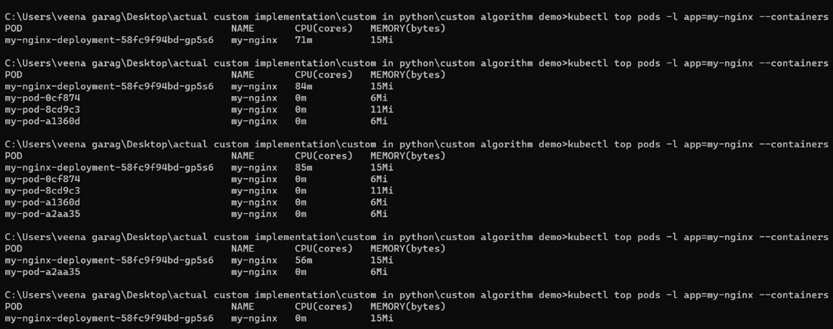
Deploying EOX microservice to Kubernetes cluster
Project Demonstration

Slide 20
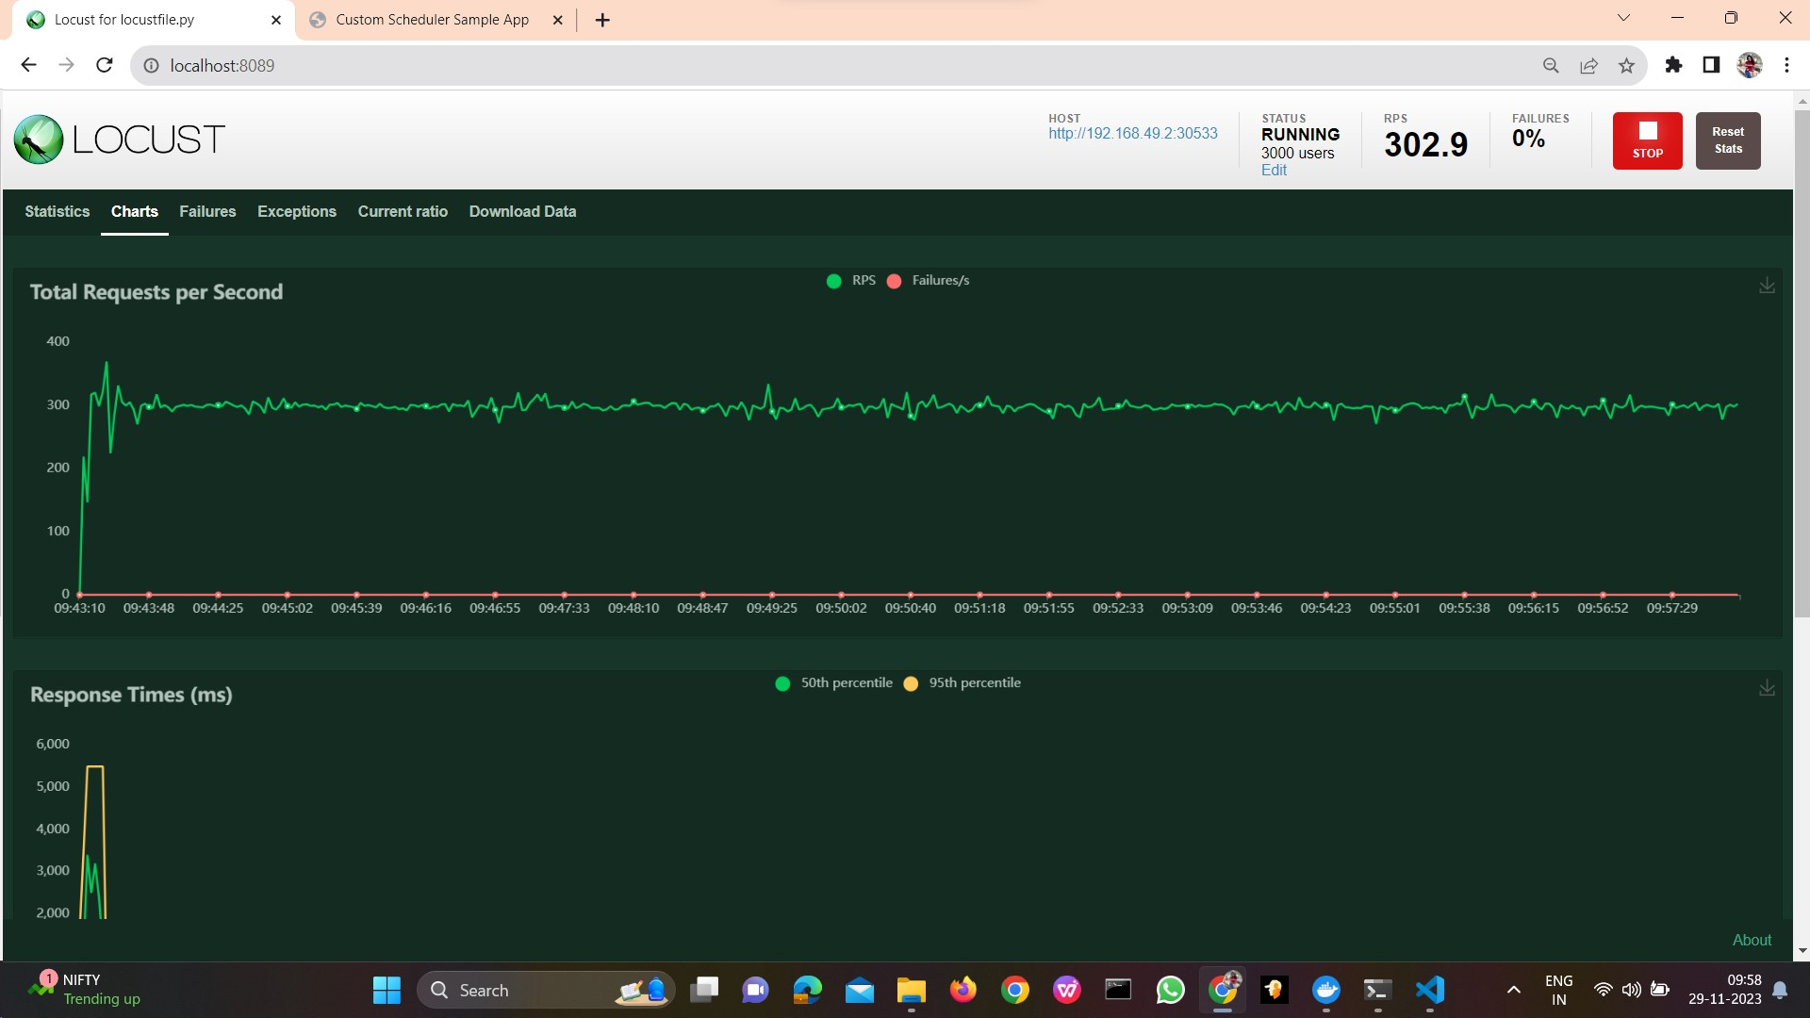
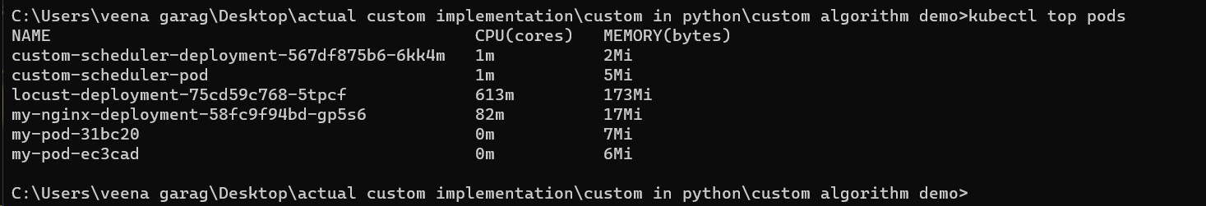
Deploying EOX microservice to Kubernetes cluster
Generation of load by 3000 users with 600 rps
Pod creation using custom scheduler during the first 2 minutes window

Slide 21
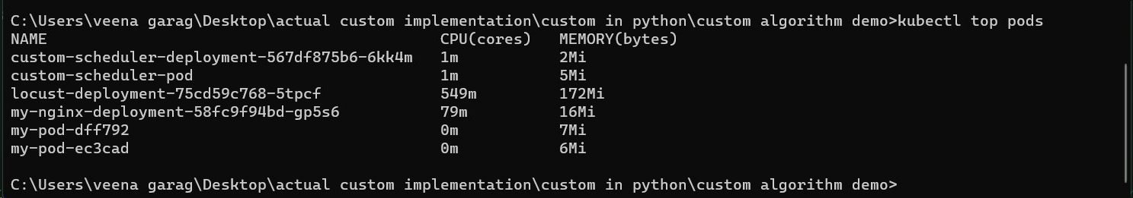
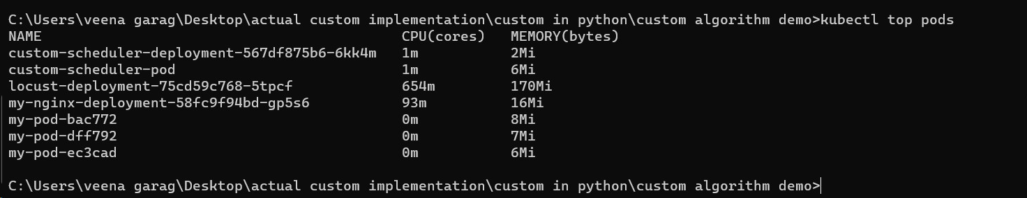
Deploying EOX microservice to Kubernetes cluster
Pod creation using custom scheduler during the first 8 minutes window
Pod creation using custom scheduler during the first 15 minutes window

Slide 22
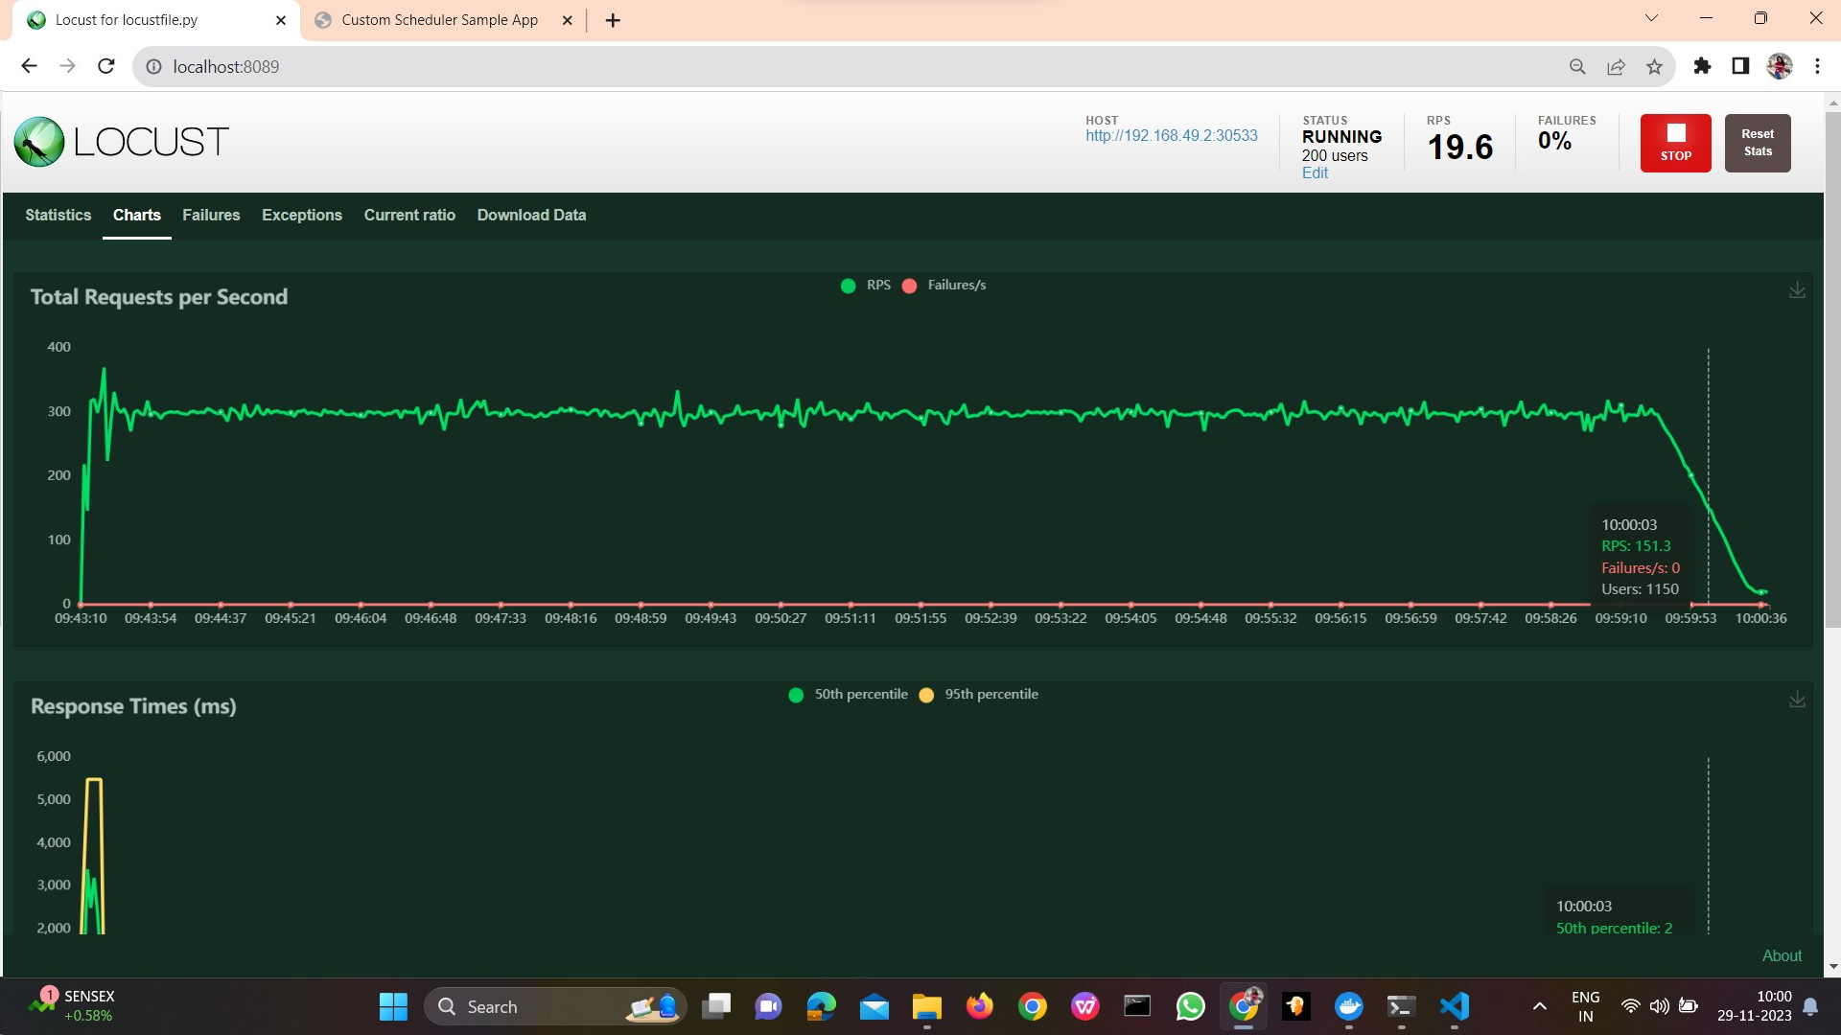
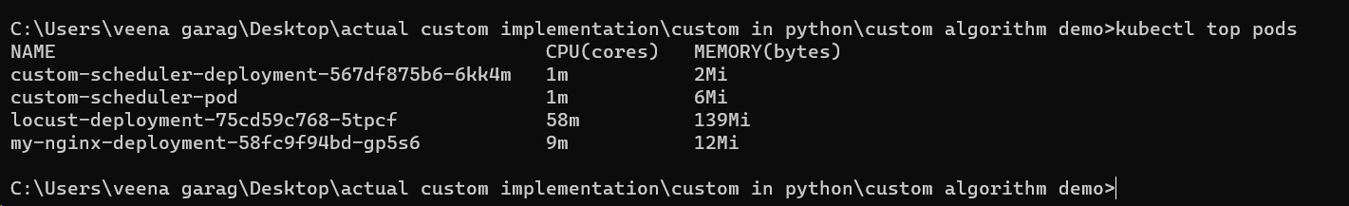
Deploying EOX microservice to Kubernetes cluster
Generation of load by 200 users 100 rps
The number of pods decreased when the load is decreased

Slide 23
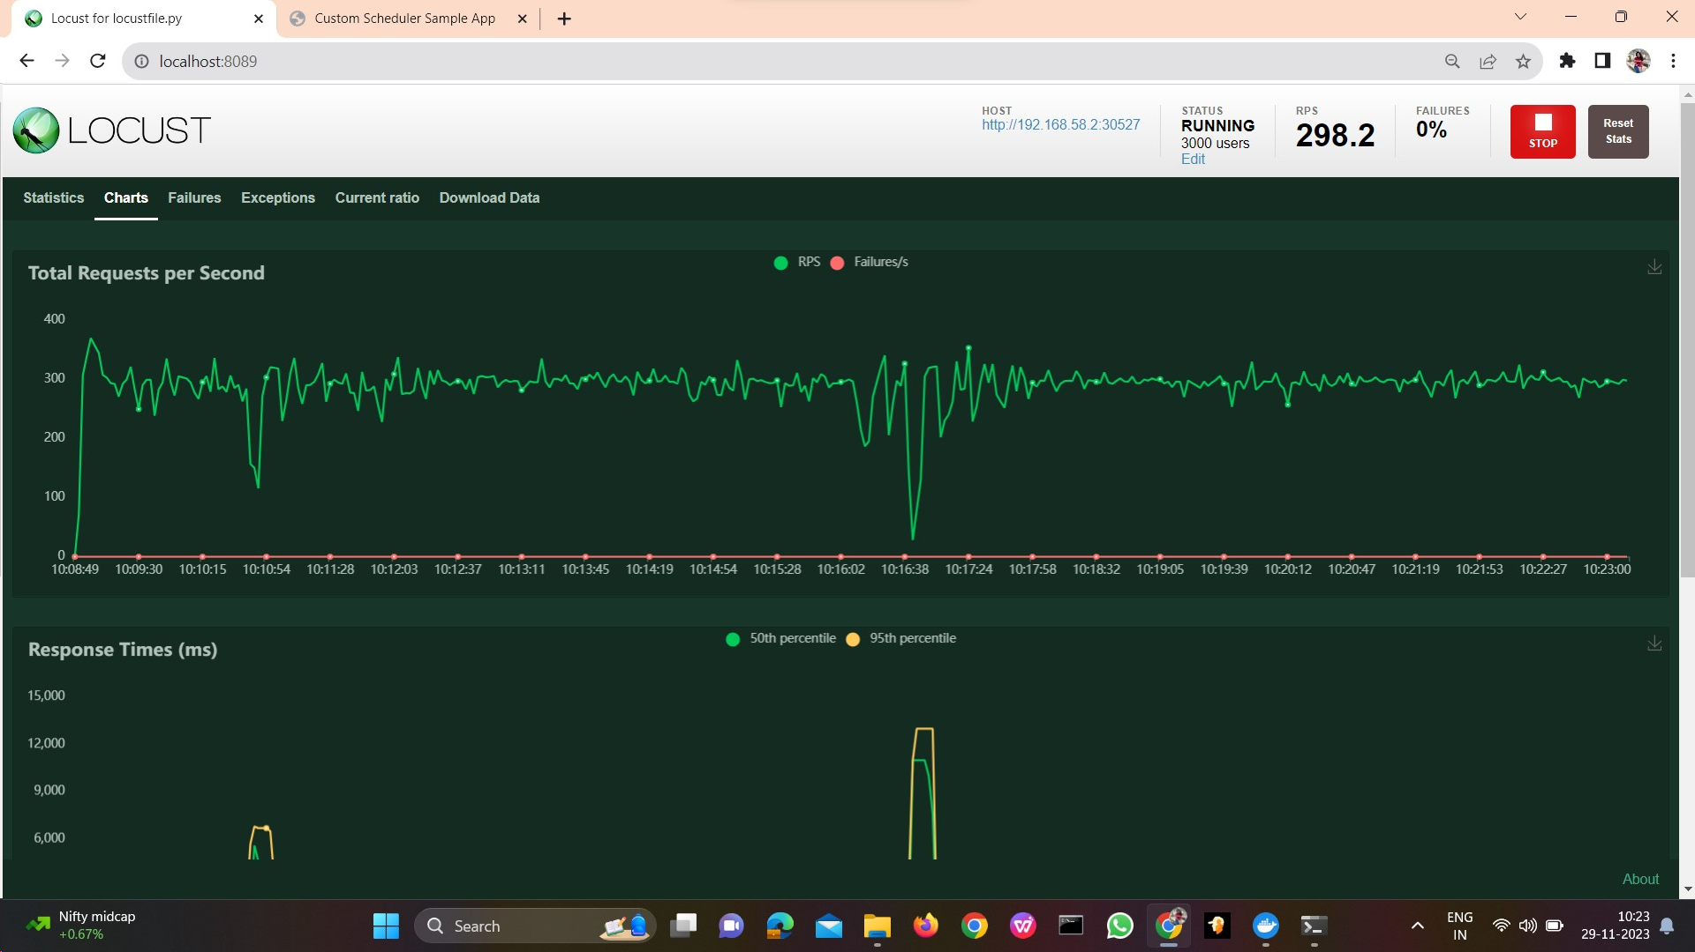
Deploying EOX microservice to Kubernetes cluster
Demonstration of working of KHPA
Load generation of 3000 users with 600 rps
Creation of replicas by KHPA based on increase of load during 2 minutes time frame

Slide 24
Deploying EOX microservice to Kubernetes cluster
Creation of replicas by KHPA based on increase of load during 8 minutes time frame.
Creation of replicas by KHPA based on increase of load during 15 minutes time frame

Slide 25
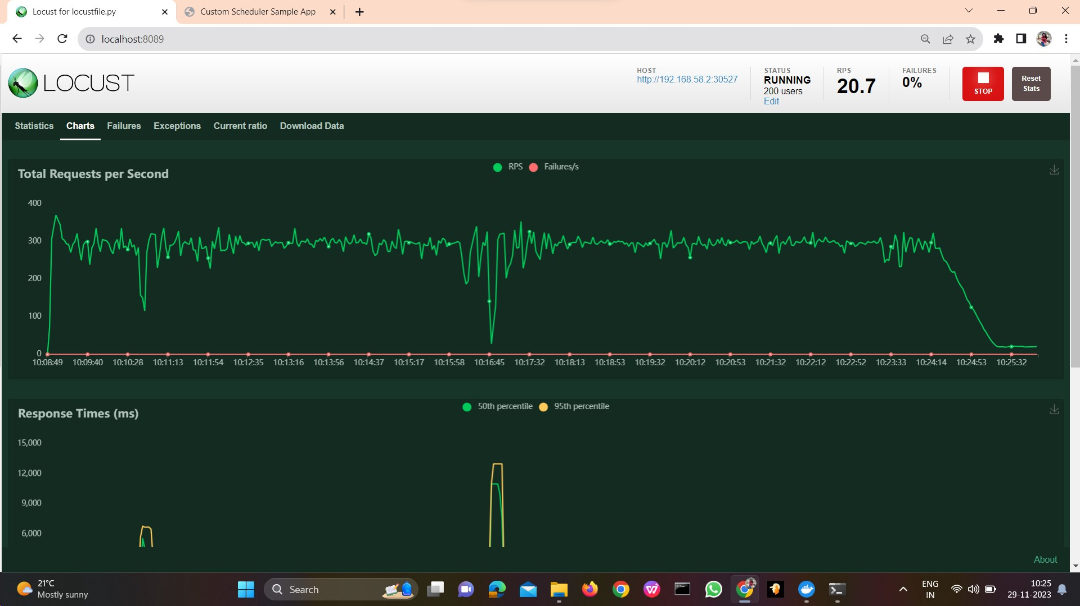
Deploying EOX microservice to Kubernetes cluster
Generation of load by 200 users 100 rps
The number of pods when the load is decreased

Slide 26
Conclusion
Deploying EOX microservice to Kubernetes cluster
The project successfully implemented a custom controller auto-scaler within a Kubernetes environment to dynamically scale a microservices-based application. This approach ensure optimal performance under varying load conditions.
The project utilizes Istio mesh networks to enhance service-to-service communication and visibility. Kailali and Prometheus are employed for comprehensive monitoring of services, while Grafana provides a centralized dashboard for visualizing and analysing key metrics.

Slide 27
Future Work
Deploying EOX microservice to Kubernetes cluster
Support for other metrics: In addition to CPU usage, we could also consider supporting other metrics, such as memory usage, network traffic, or response time. This would give us more granular control over how your scheduler scales our microservices.
Predictive scaling: Instead of reacting to current CPU usage, we could use predictive scaling to anticipate future load and scale our microservices accordingly. This could help to avoid performance bottlenecks and improve overall scalability. This could be done using machine learning to train a model on historical CPU usage data.
Integrate with CI/CD pipelines: This would allow us to automatically deploy our custom scheduler to your Kubernetes cluster. We could also use CI/CD pipelines to collect feedback on the performance of your scheduler and to make improvements over time.

Slide 28
Deploying EOX microservice to Kubernetes cluster
References
Deshpande, Neha (2021) Autoscaling Cloud-Native Applications using Custom Controller of Kubernetes.
https://norma.ncirl.ie/5089/
Masters thesis, Dublin, National College of Ireland.
Shitole, Abhishek Sanjay (2022) Dynamic Load Balancing of Microservices in Kubernetes Clusters using Service Mesh.
https://norma.ncirl.ie/5943/
Masters thesis, Dublin, National College of Ireland.
Nandan Adhikari (April 19, 2021) Horizontal Pod Autoscaler in Kubernetes https://around25.com/blog/horizontal-pod-autoscaler-in-kubernetes/
An Efficient and Scalable Traffic Load Balancing Based on Web Server Container Resource Utilization using Kubernetes Cluster.(May – 2022) Ashok L Pomnar,
AVCOE Sangamner 422 605,Maharashtra, India.
https://ijisrt.com/assets/upload/files/IJISRT22MAY1644_(1)_(1).pdf
V. Sharma, "Managing Multi-Cloud Deployments on Kubernetes with Istio, Prometheus and Grafana," 2022 8th International Conference on Advanced Computing and Communication Systems (ICACCS), Coimbatore, India,
https://doi.org/10.1109/ICACCS54159.2022.9785124

Slide 29
Deploying EOX microservice to Kubernetes cluster
Thank You

